Slide 1
Making GGPlot Sing
Nashville RUser Meetup
August 28,2014

Slide 2
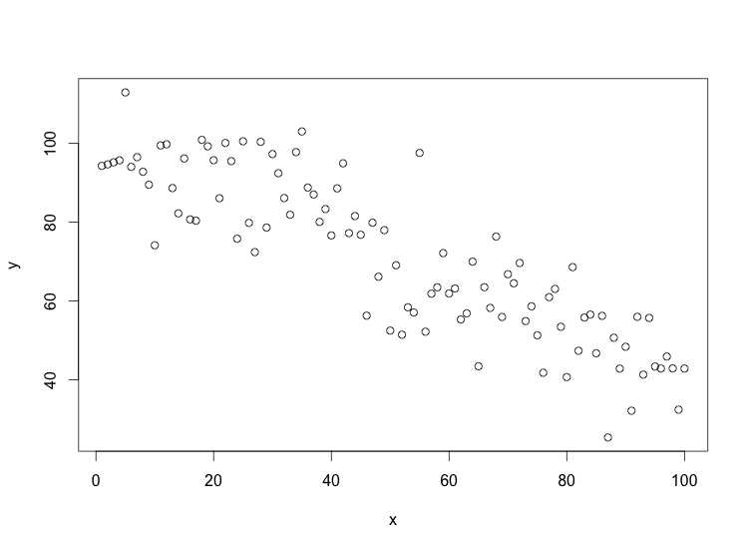
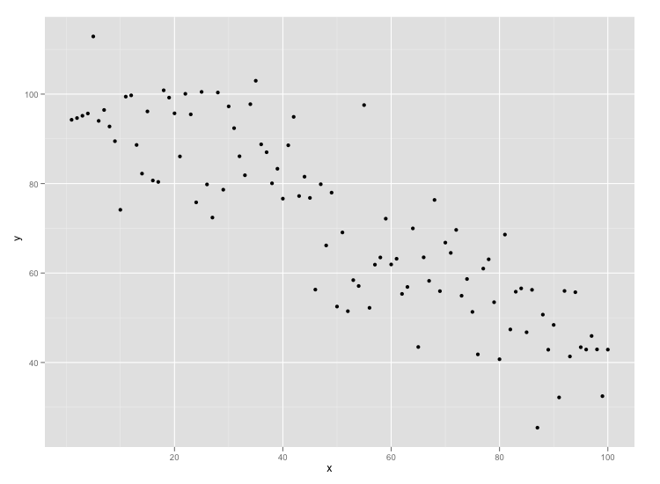
Why use GGPlot2?
Prettier
More easily customizable
Broad user community
Easier to learn the tough stuff
Makes you think about your data and your graphic!!

Slide 3
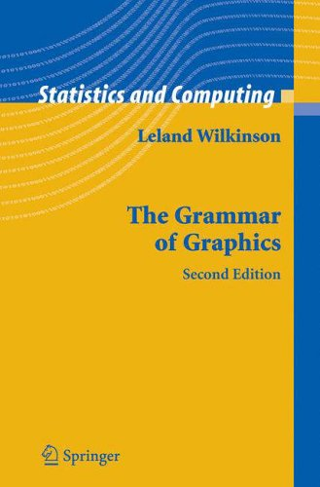
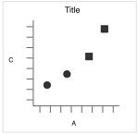
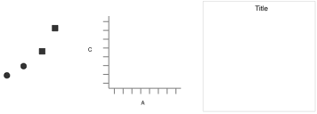
Why the double G?
See Hadley’s Original Paper: http://vita.had.co.nz/papers/layered-grammar.pdf
Notes:
For more background on GoG and Ggplot read the original paper by Hadley Wickham: http://vita.had.co.nz/papers/layered-grammar.pdf

Slide 4
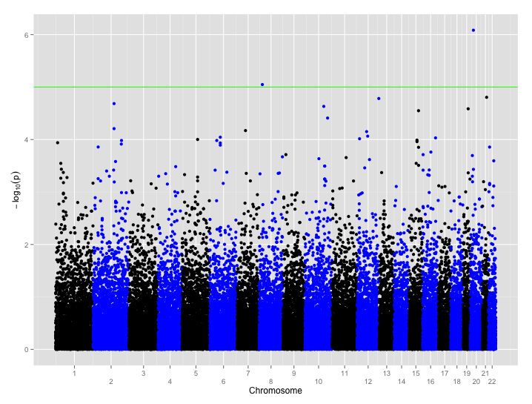
What we’re covering tonight
Scatter plot
Changing axis point labels
Special Text Options
Changing labels
Changing colors
Text Annotation
Changing fonts
Dealing with legends

Slide 5
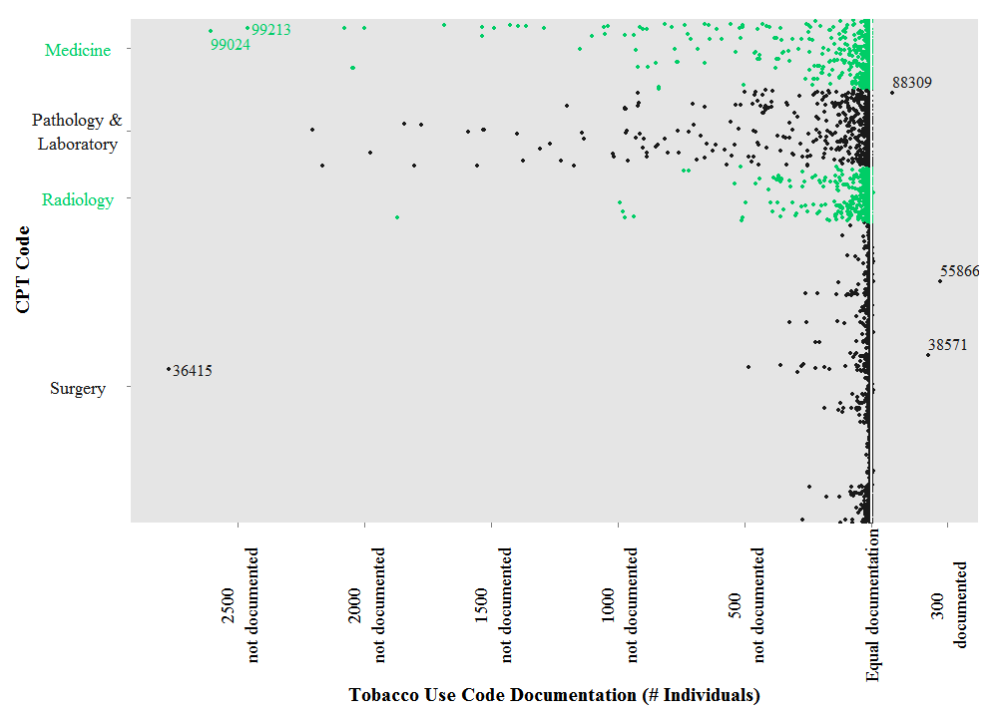
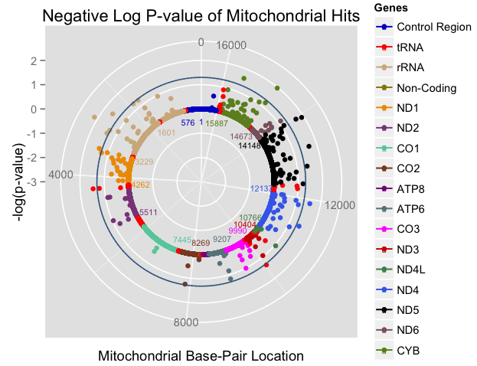
Examples – Change Axis Orientation

Slide 6
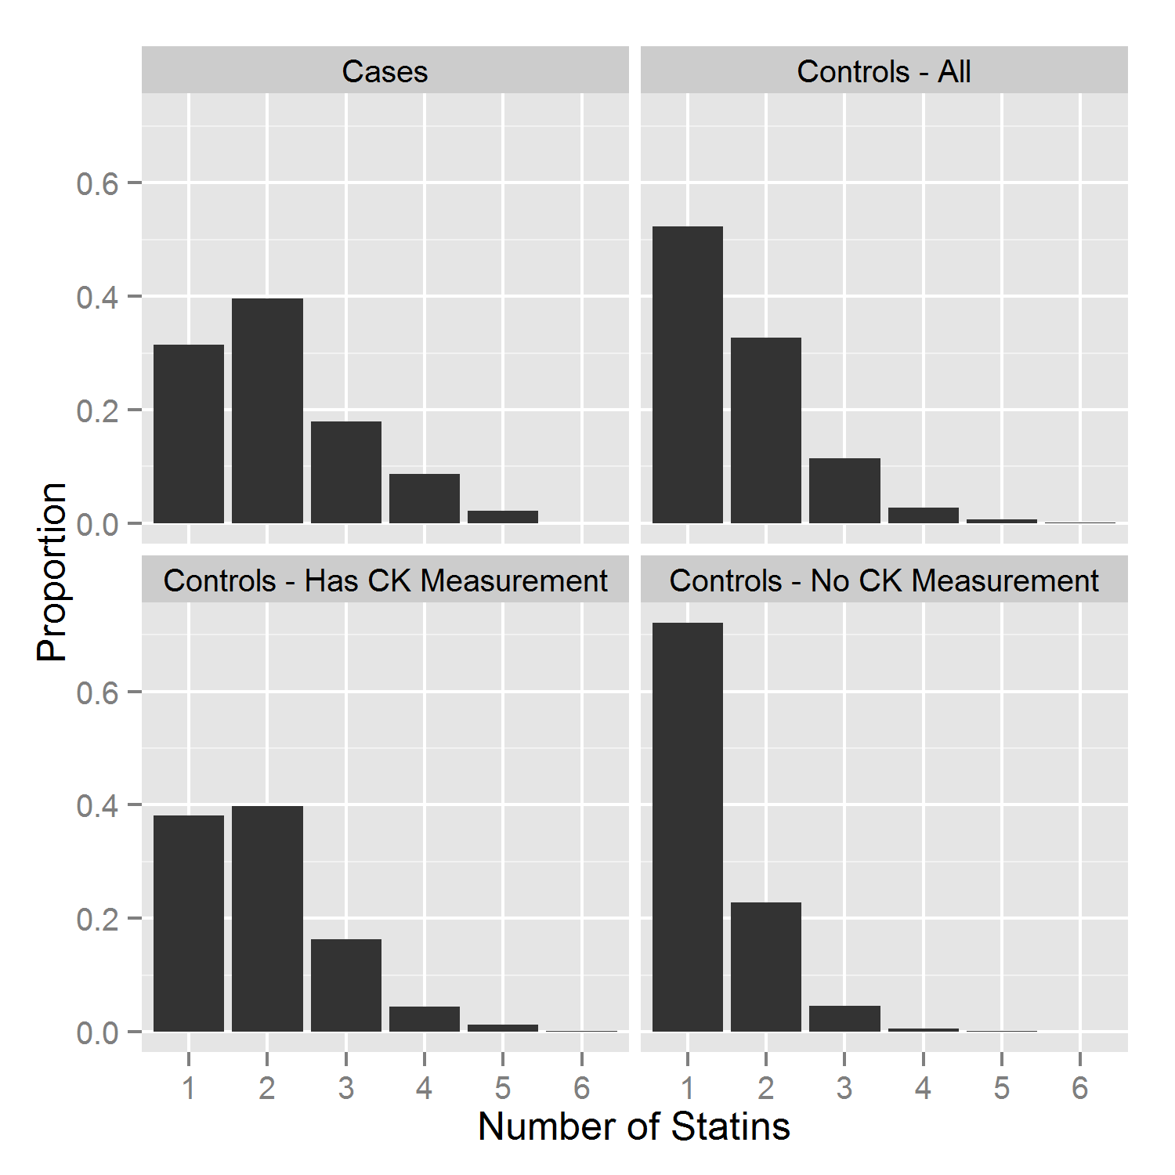
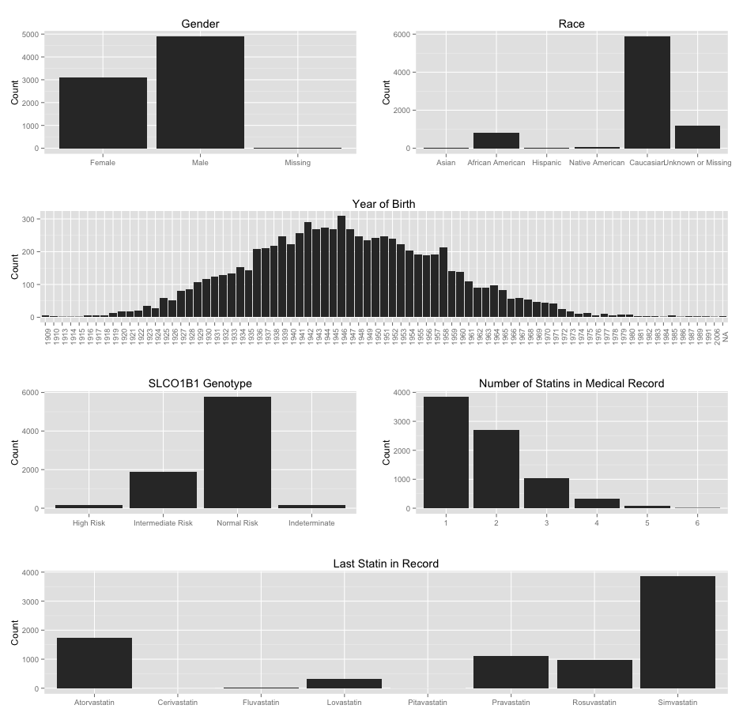
Examples – Faceting / Grouping

Slide 7
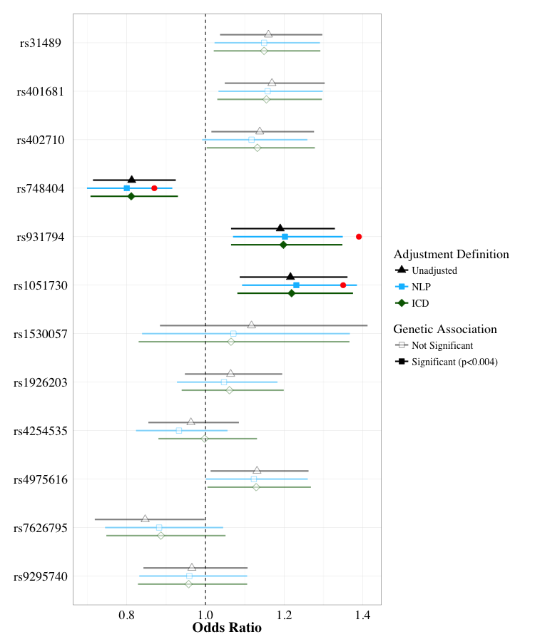
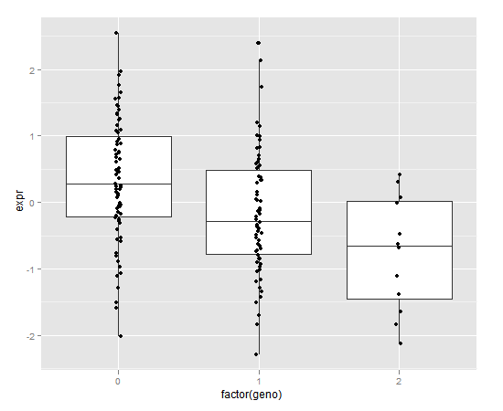
Examples – Mixing Geoms

Slide 8
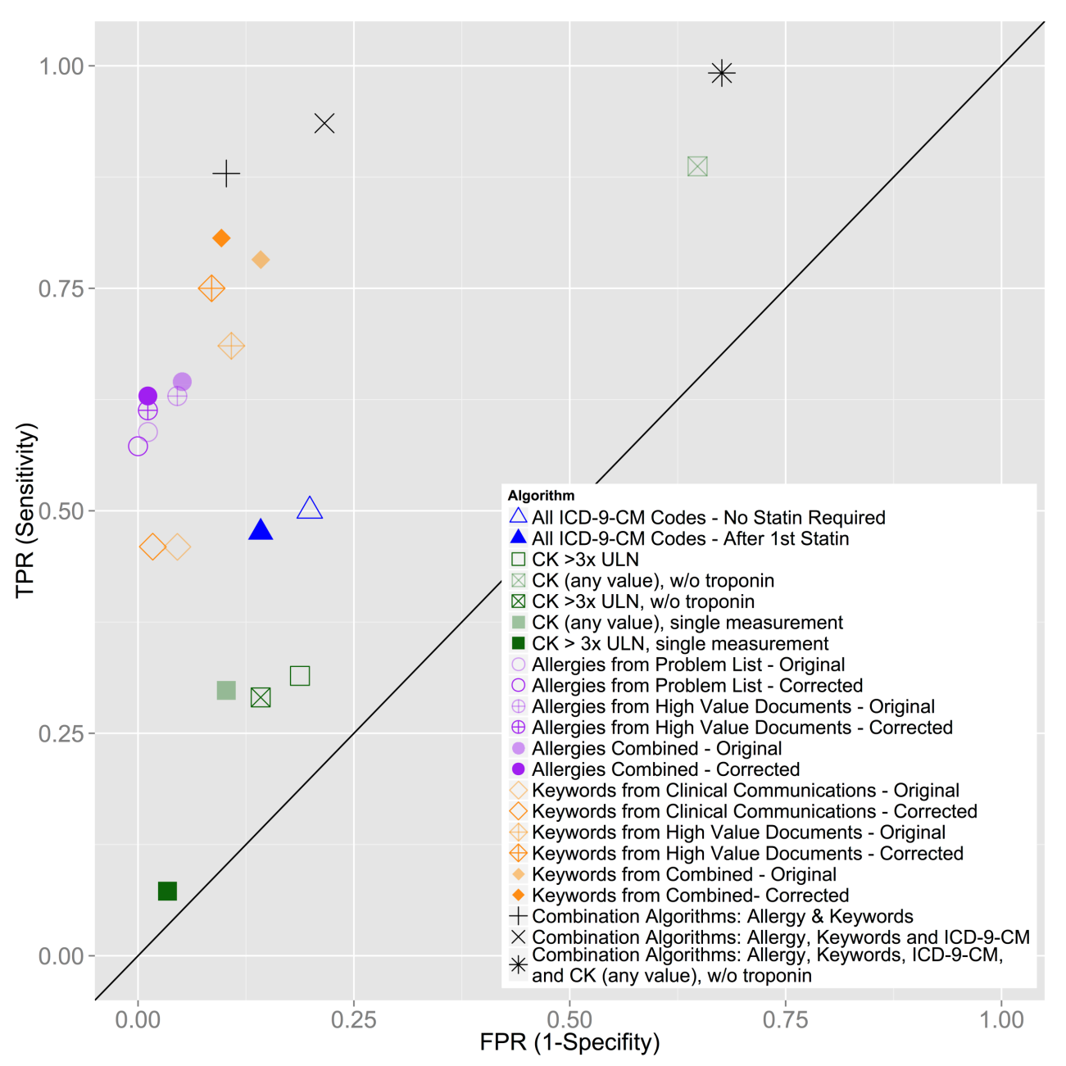
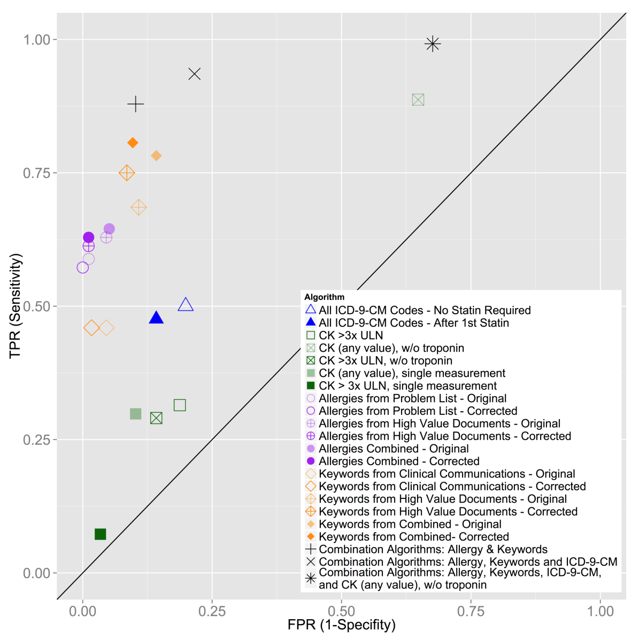
Examples – Legend Position, shapes

